Slide 1
Lecture 19: Classes – Part II
Class page: https://github.com/tsung-wei-huang/cs1410-40
Dr. Tsung-Wei Huang
Department of Electrical and Computer Engineering
University of Utah, Salt Lake City, UT
Notes:
Morning everyone
Today we are looking into control flow in C++.

Slide 2
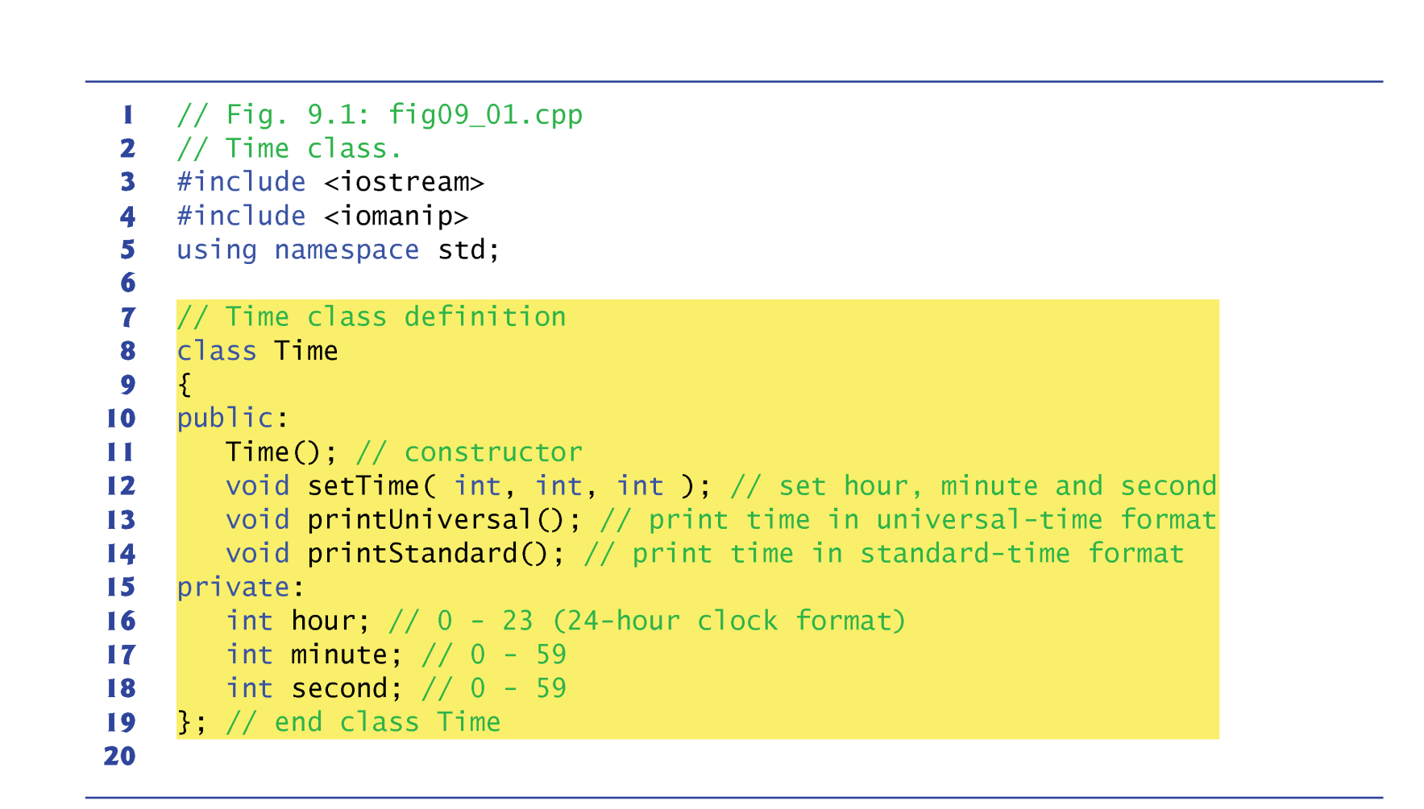
Review: Time Class

Slide 3
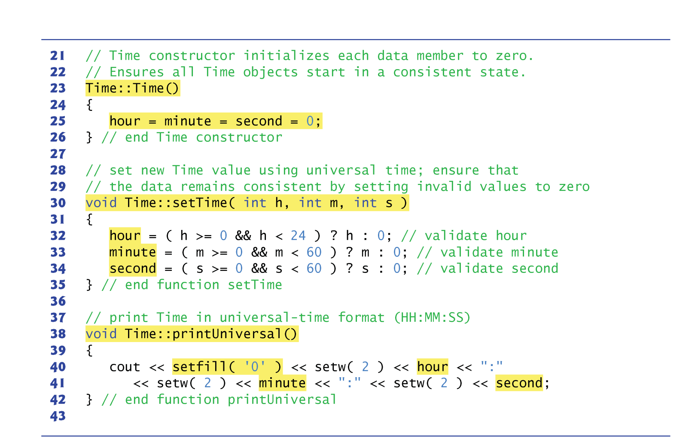
Review: Time Class

Slide 4
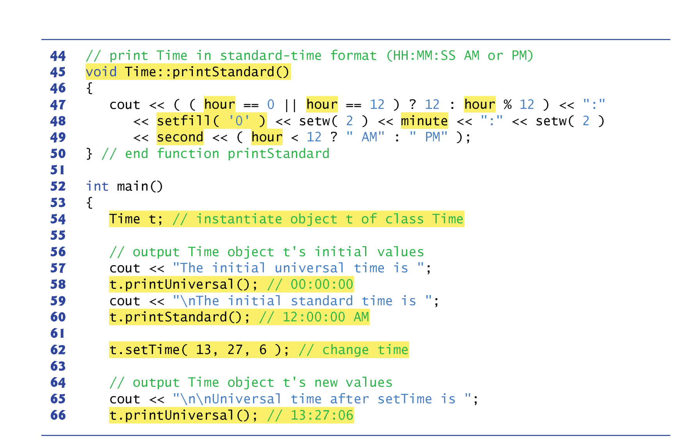
Review: Time Class

Slide 5
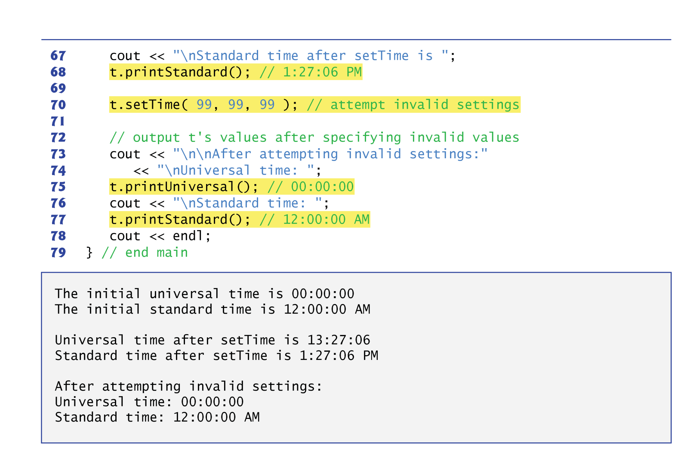
Review: Time Class

Slide 6
Constructor with Default Arguments
This example enhances class Time to demonstrate how arguments are implicitly passed to a constructor.
Like other functions, constructors can specify default arguments.
Line 11 declares the Time constructor to include default arguments (zero for each argument).
The constructor calls member function setTime with the values passed to the constructor (or the default values).
If a value is out of range, that value is set to zero (to ensure that each data member remains in a consistent state).

Slide 7
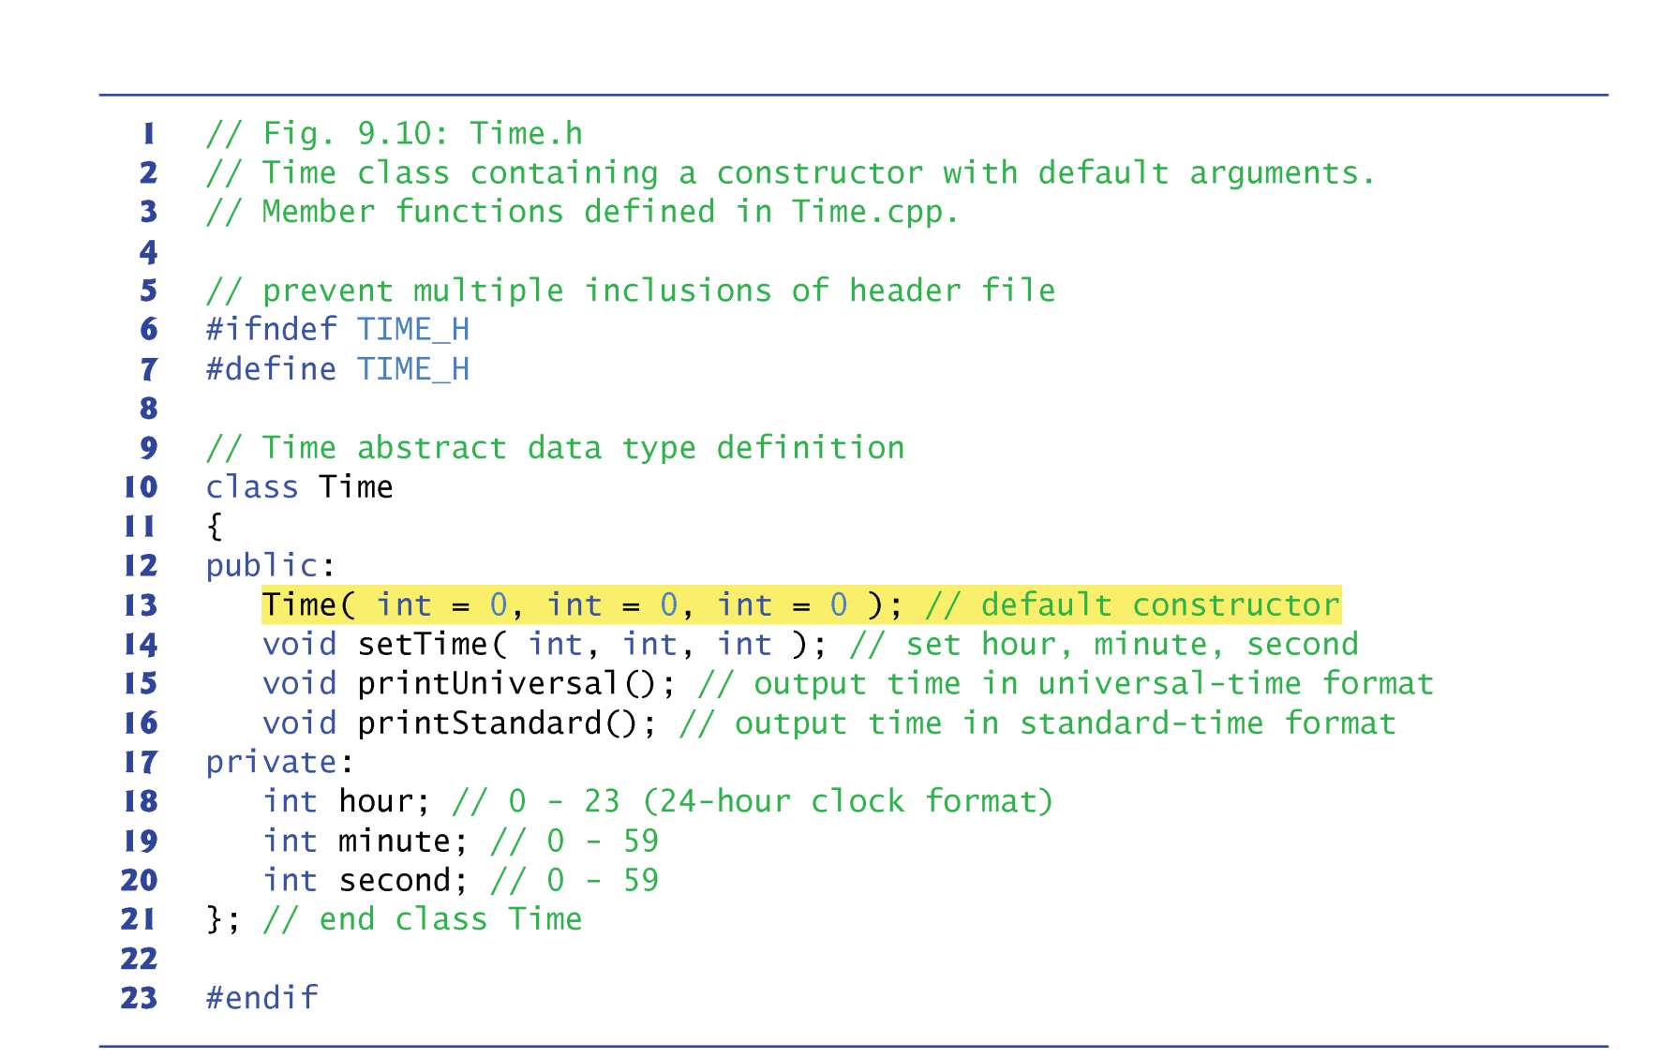
Constructor with Arguments

Slide 8
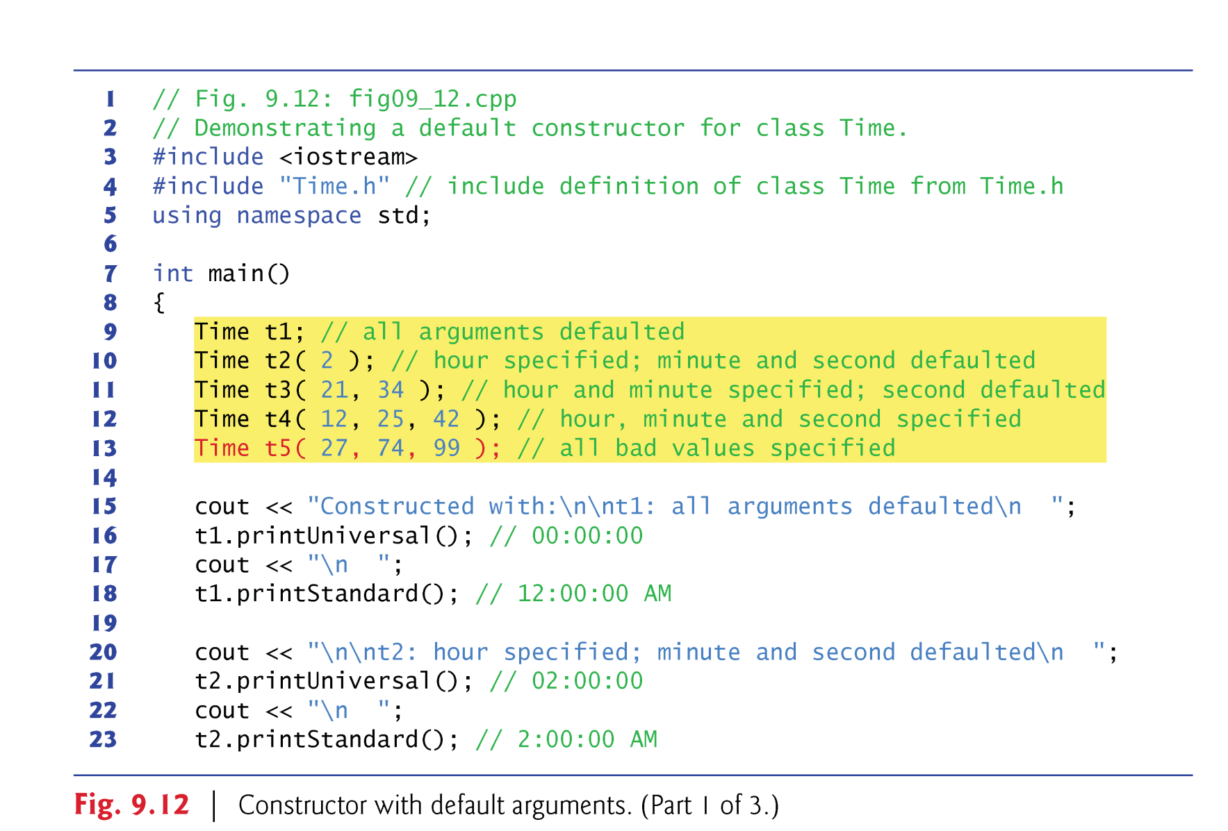
Constructors with Arguments

Slide 9
Constructor with Default Arguments
Any constructor that takes no arguments is called a default constructor.
A class gets a default constructor in one of two ways:
The compiler implicitly creates a default constructor in a class that does not define a constructor.
Such a constructor does not initialize the class’s data members, but does call the default constructor for each data member that’s an object of another class.
You explicitly define a constructor that takes no arguments.
Such a default constructor will call the default constructor for each data member that’s an object of another class and will perform additional initialization specified by you.
If you define a constructor with arguments, C++ will not implicitly create a default constructor for that class.

Slide 10
Destructor
The name of the destructor for a class is the tilde character (~) followed by the class name.
Another type of special member function.
The destructor is called implicitly when an object is destroyed.
For example, an automatic object is destroyed when program execution leaves its scope in which that object was instantiated.
A destructor receives no parameters and returns no value.
May not specify a return type—not even void.
A class may have only one destructor.
A destructor must be public.
If you do not explicitly provide a destructor, the compiler creates an “empty” destructor.

Slide 11
When Constructor and Destructor called?
Constructors and destructors are called implicitly by the compiler.
The order in which these function calls occur depends on the order in which execution enters and leaves the scopes where the objects are instantiated.
Generally, destructor calls are made in the reverse order of the corresponding constructor calls
The storage classes of objects can alter the order in which destructors are called.

Slide 12
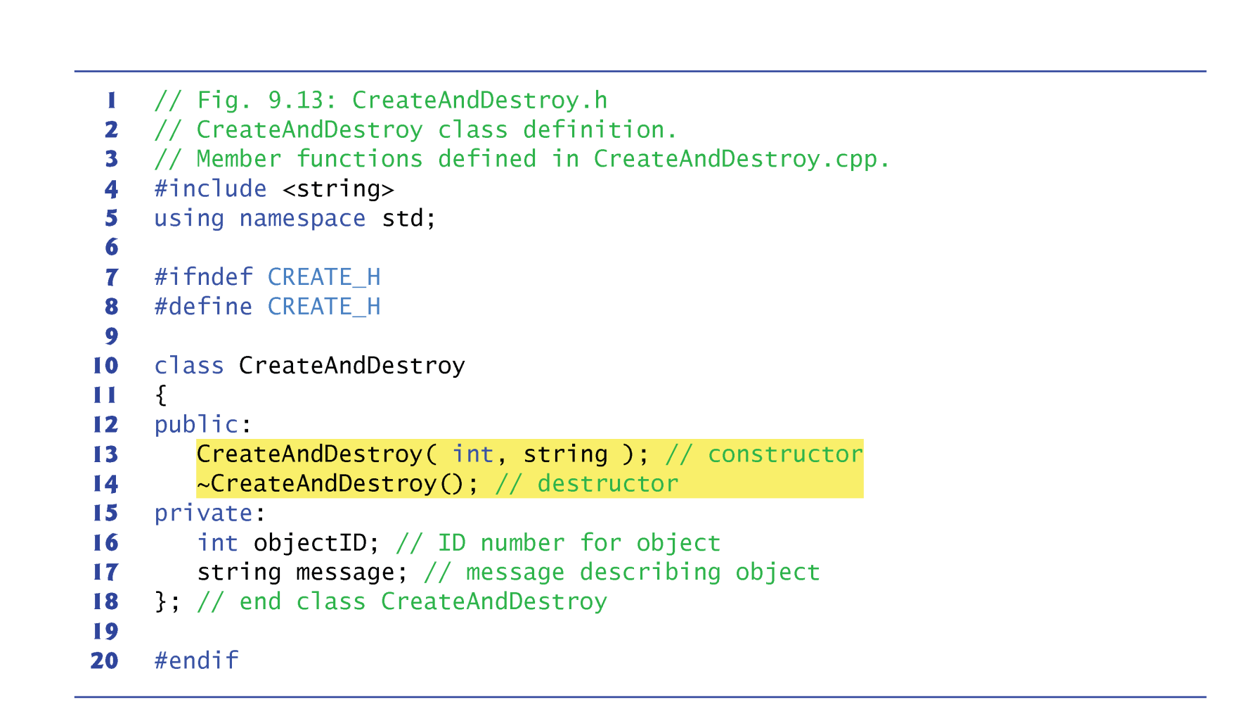
Example

Slide 13
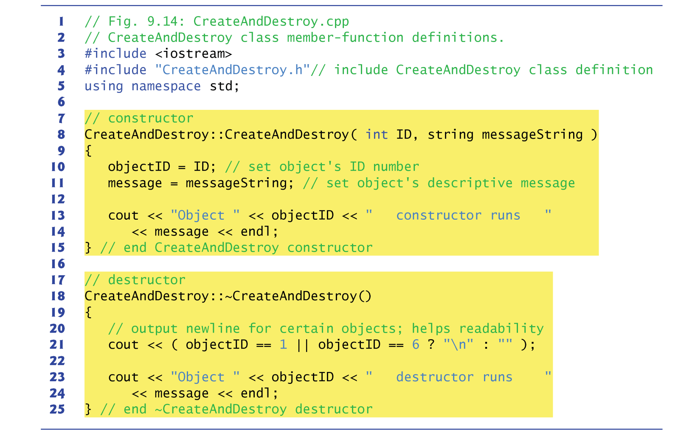
Example

Slide 14
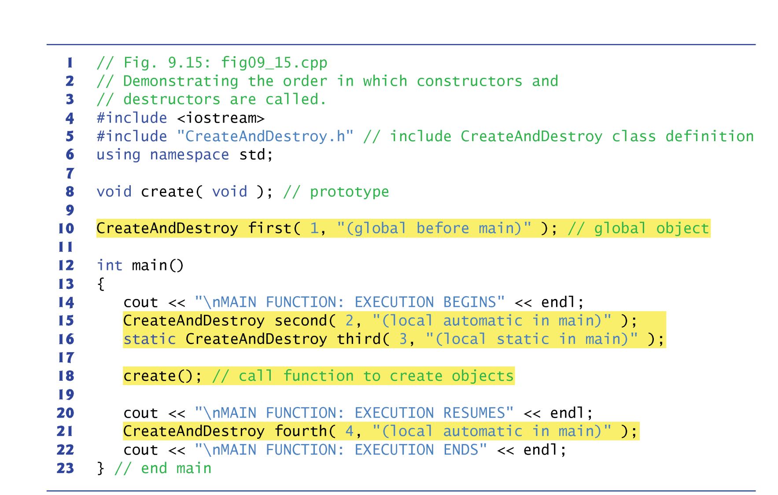
Example

Slide 15
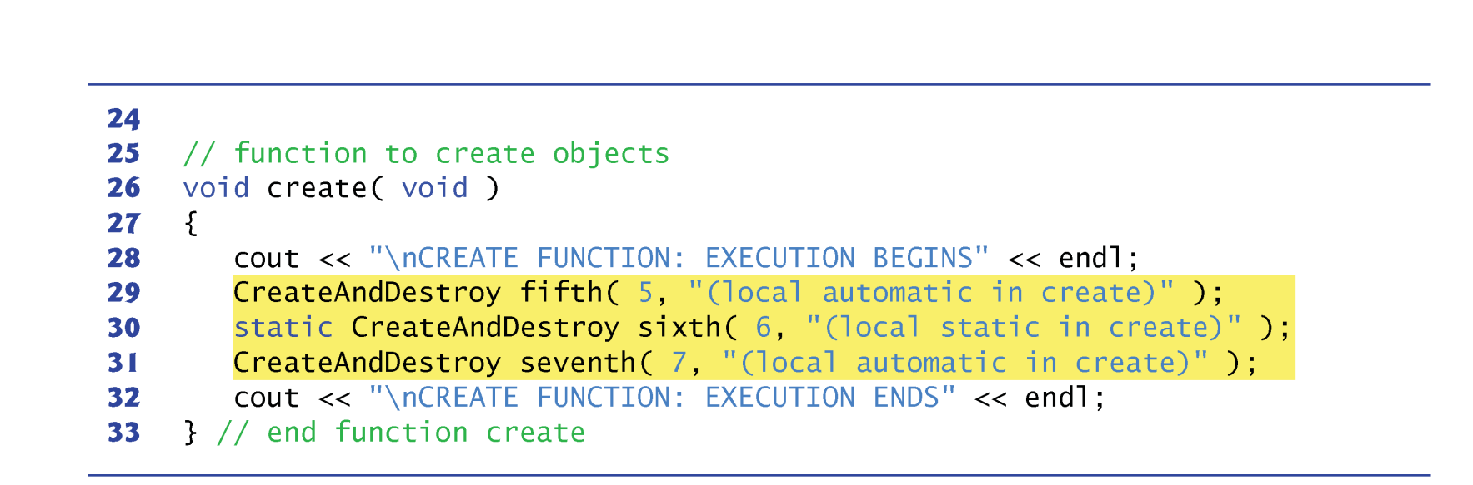
Example

Slide 16
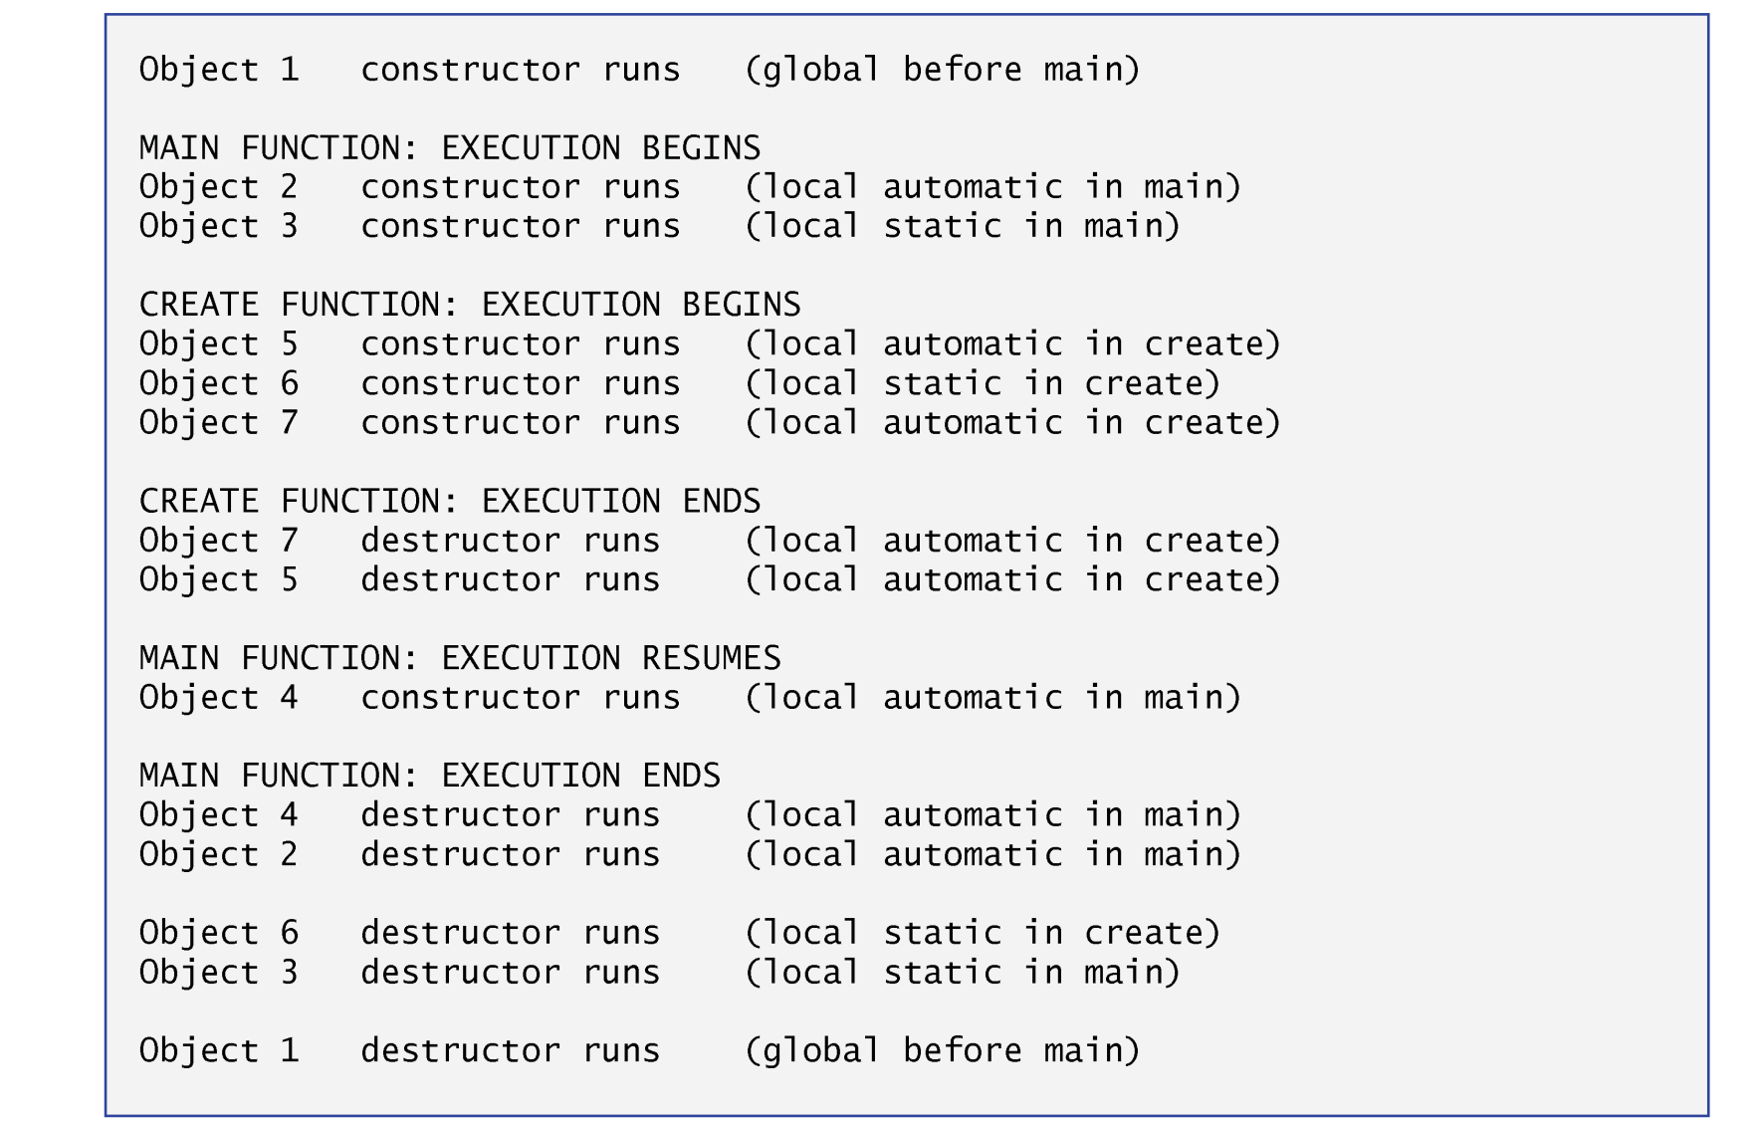
Example

Slide 17
Accessors and Modofiers
Classes often provide public member functions to allow clients of the class to set (i.e., assign values to) or get (i.e., obtain the values of) private data members.
These member function names need not begin with set or get, but this naming convention is common.
This example enhances class Time to include public functions that allow the client code to set and get the values of the private data members hour, minute and second.
The set functions strictly control the setting of the data members.
Each get function simply returns the appropriate data member’s value.

Slide 18
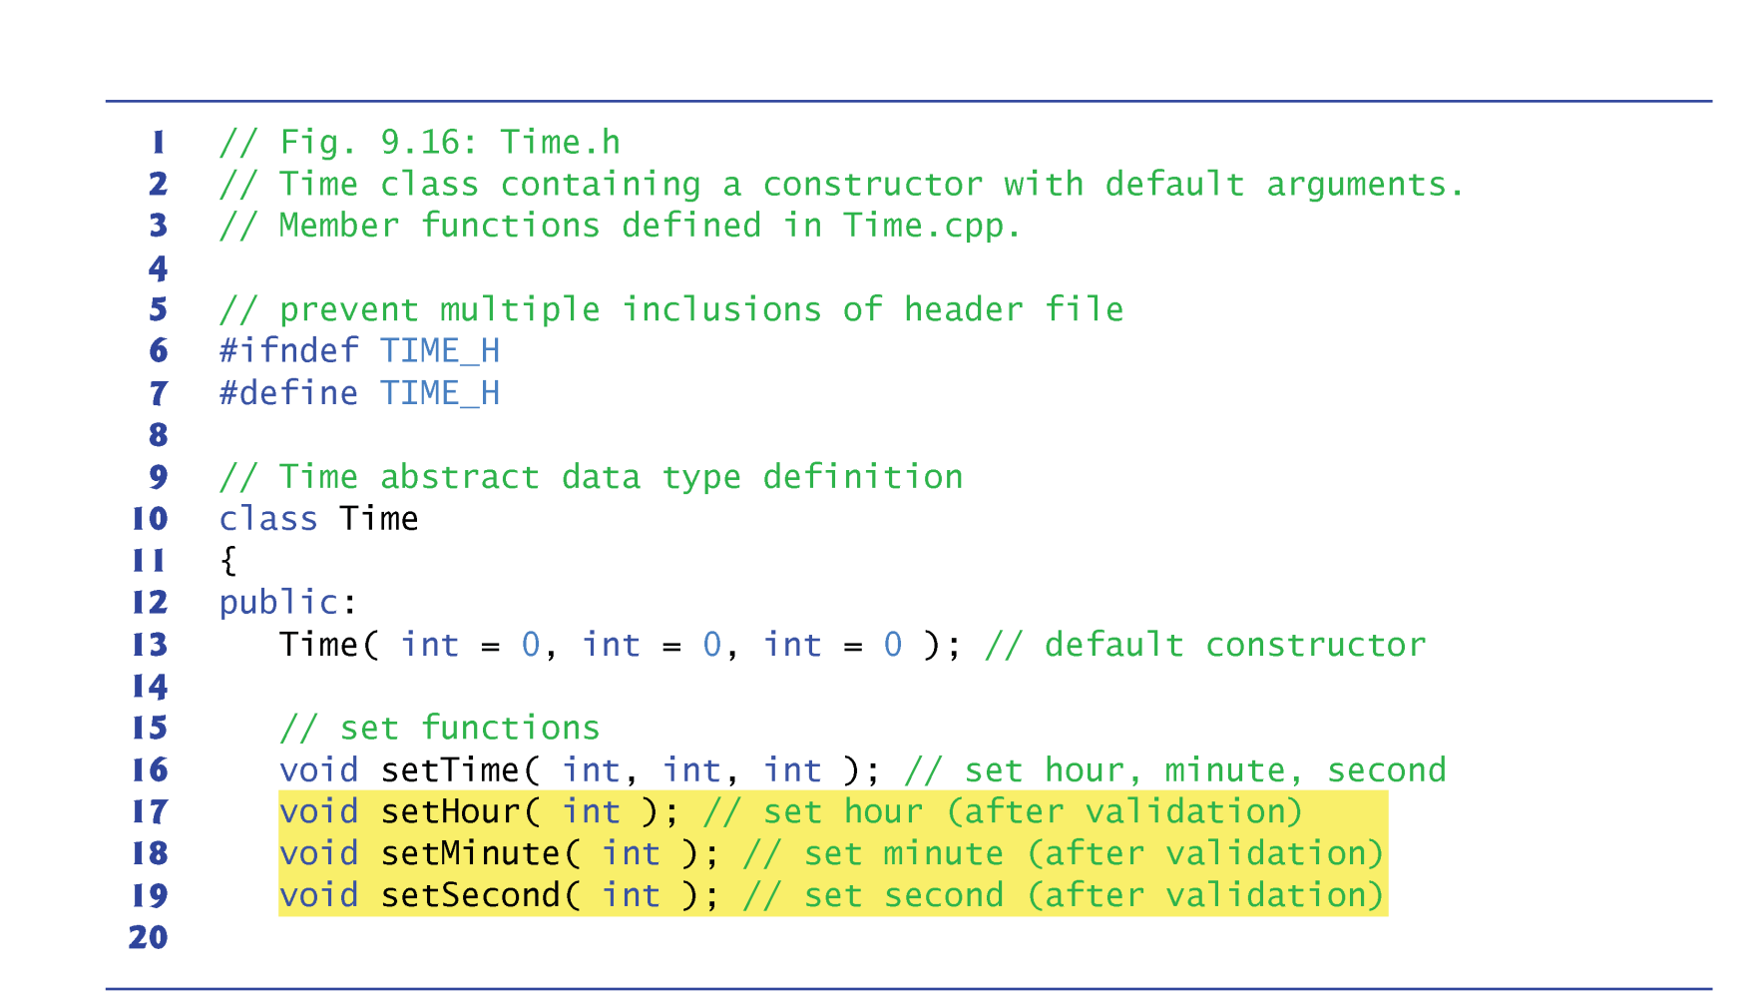
Example

Slide 19
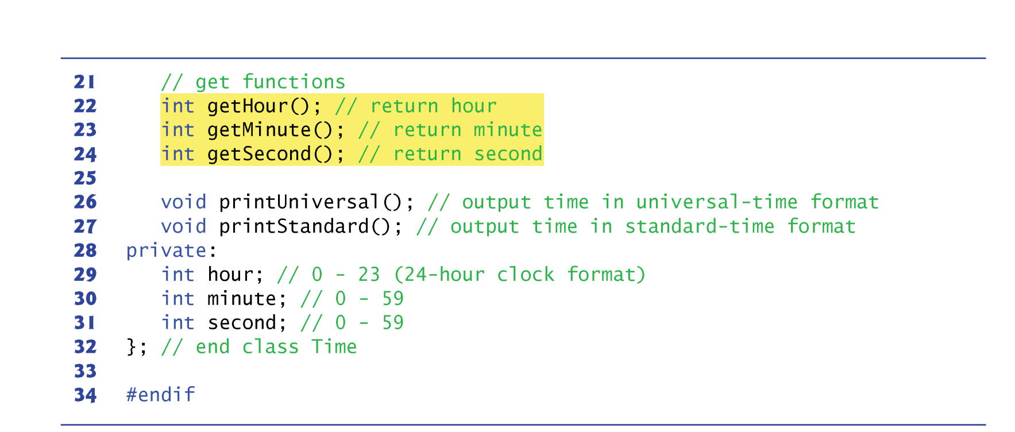
Example

Slide 20
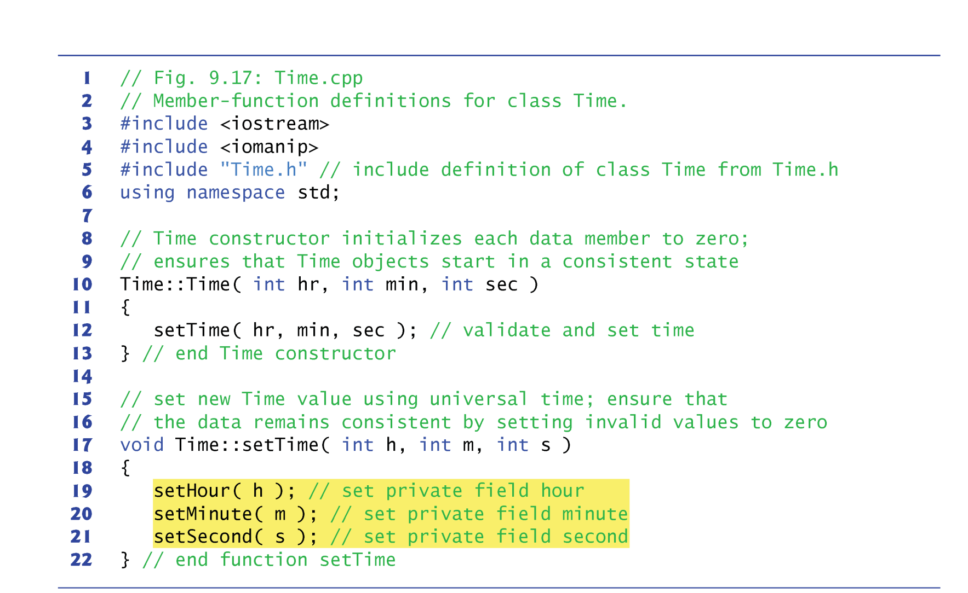
Example

Slide 21
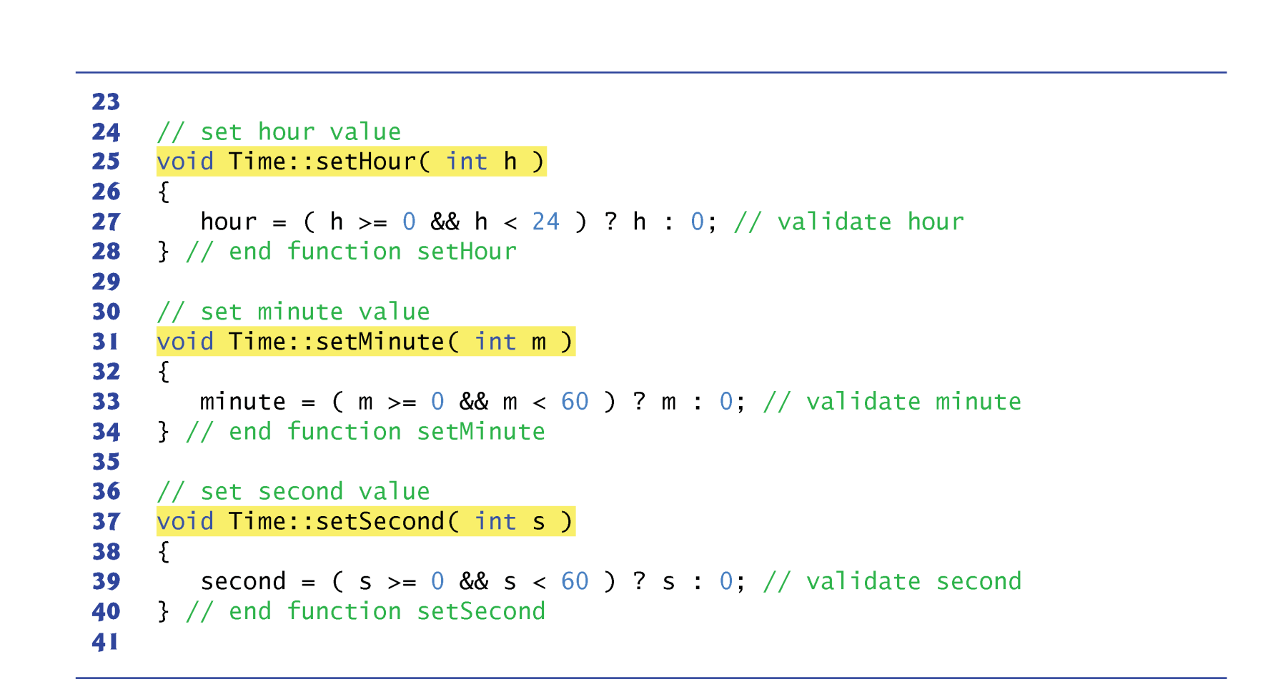
Example

Slide 22
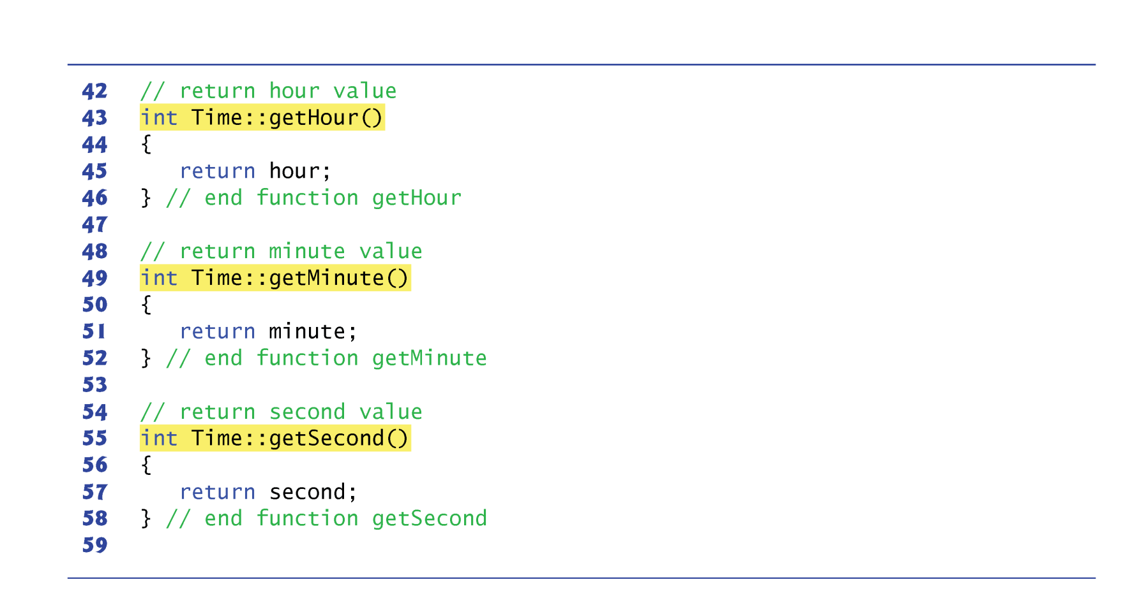
Example

Slide 23
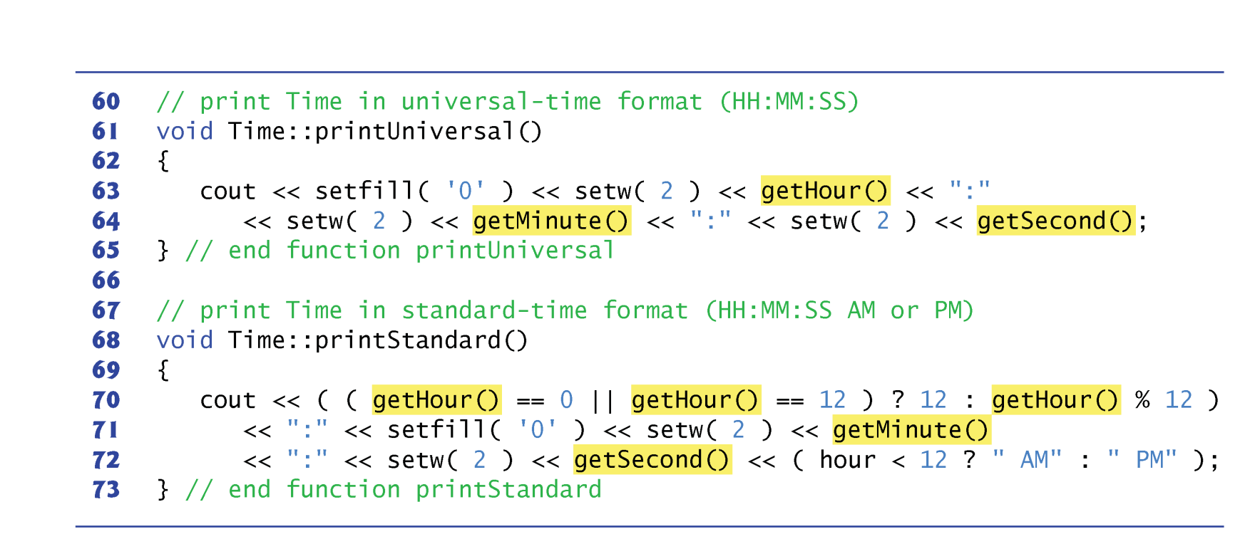
Example

Slide 24
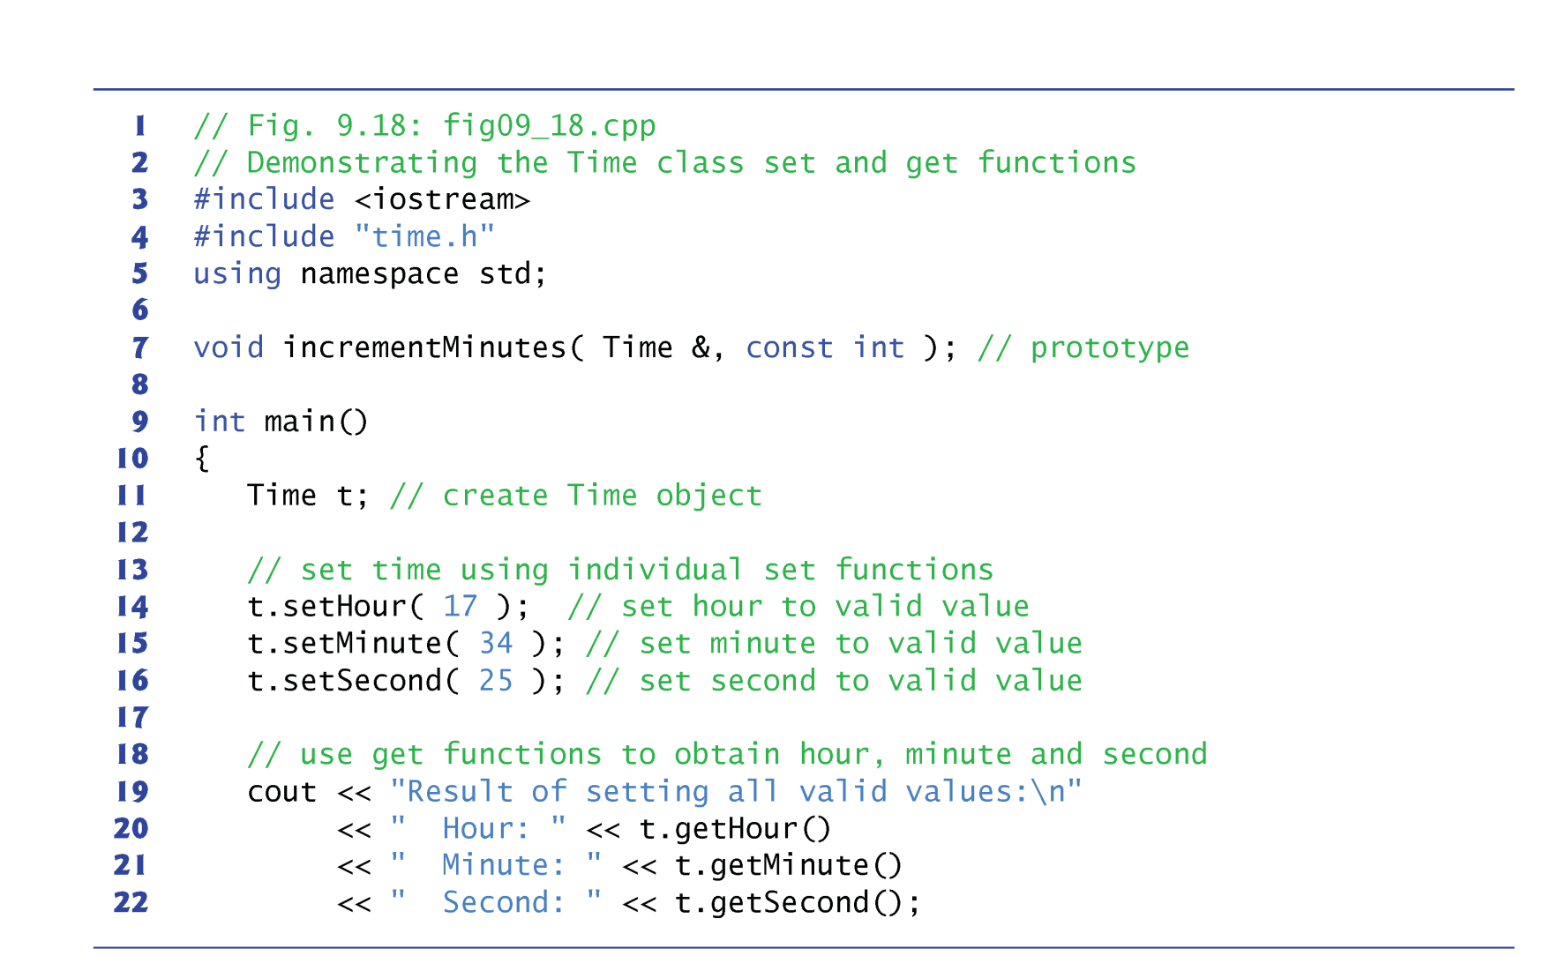
Example

Slide 25
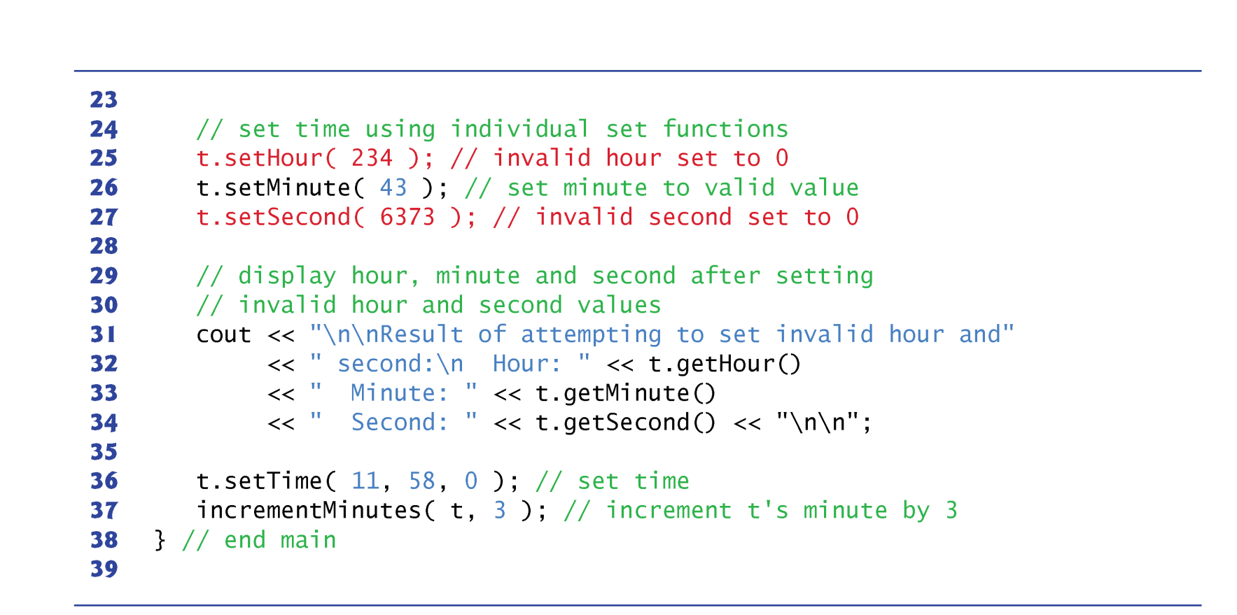
Example

Slide 26
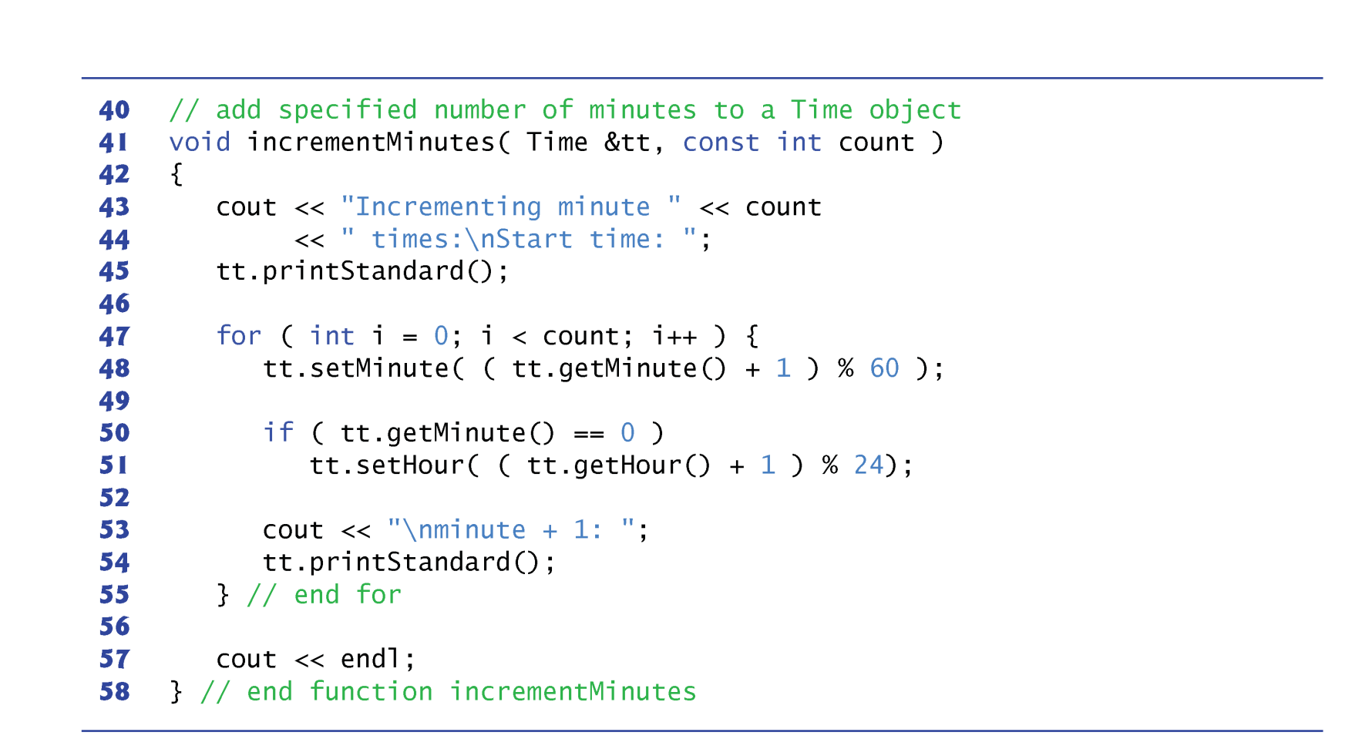
Example

Slide 27
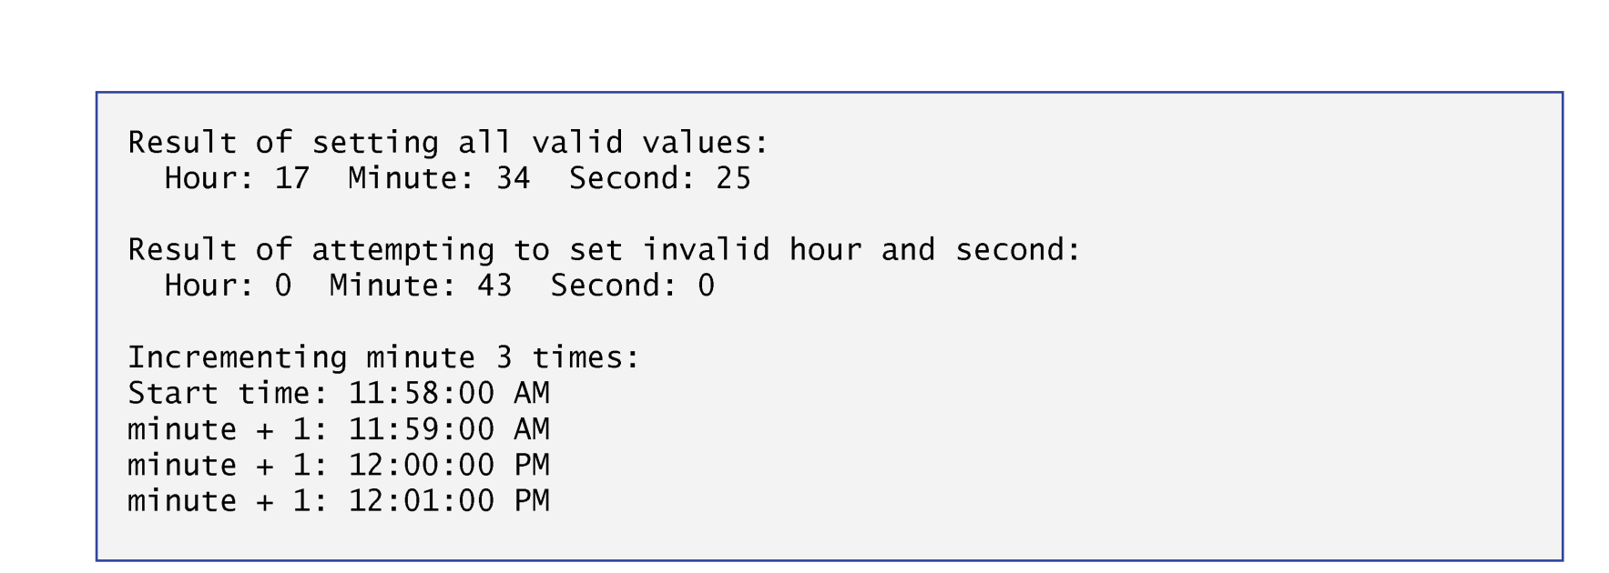
Example

Slide 28
Member Scope
Declaring data members with access specifier private enforces data hiding.
Providing public set and get functions allows clients of a class to access the hidden data, but only indirectly.
The client knows that it’s attempting to modify or obtain an object’s data, but the client does not know how the object performs these operations.
In some cases, a class may internally represent a piece of data one way, but expose that data to clients in a different way.
The set and get functions allow a client to interact with an object, but the object’s private data remains safely encapsulated (i.e., hidden) in the object itself.

Slide 29
Member Scope
Time’s set and get functions are called throughout the class’s body.
Consider changing the representation of the time from three int values to a single int value
Represent the total number of seconds elapsed since midnight.
Only the bodies of the functions that access the private data directly would need to change.
Those set and get functions for the hour, minute and second.
There would be no need to modify the bodies of functions setTime, printUniversal or printStandard.

Slide 30
Member Scope
Designing the class in this manner reduces the likelihood of programming errors when altering the class’s implementation.
Similarly, the Time constructor could be written to include a copy of the appropriate statements from function setTime.
Doing so may be slightly more efficient, because the extra constructor call and call to setTime are eliminated.
However, duplicating statements in multiple functions or constructors makes changing the class’s internal data representation more difficult.
Having the Time constructor call function setTime directly requires any changes to the implementation of setTime to be made only once.

Slide 31
Access Private Data Member?
A reference to an object is an alias for the name of the object and, hence, may be used on the left side of an assignment statement.
In this context, the reference makes a perfectly acceptable lvalue that can receive a value.
One way to use this capability (unfortunately!) is to have a public member function of a class return a reference to a private data member of that class.
If a function returns a const reference, that reference cannot be used as a modifiable lvalue.

Slide 32
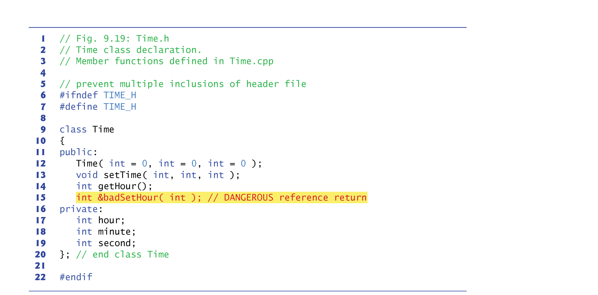
Example

Slide 33
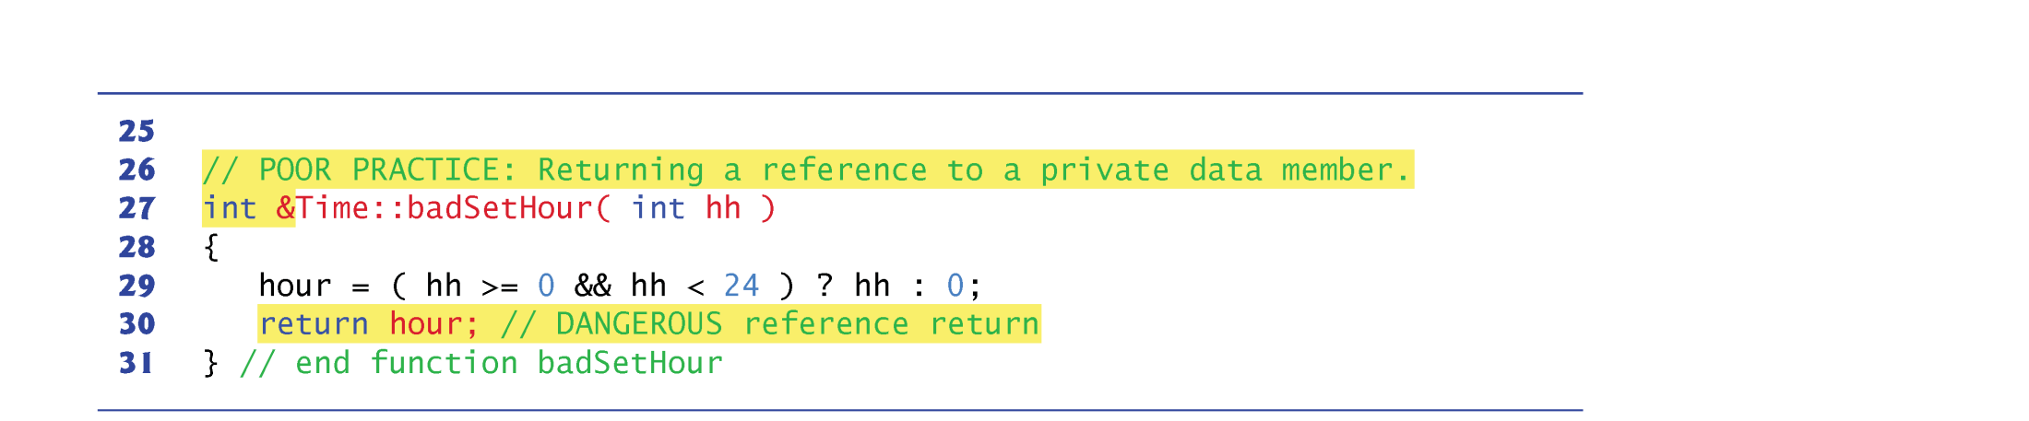
Example

Slide 34
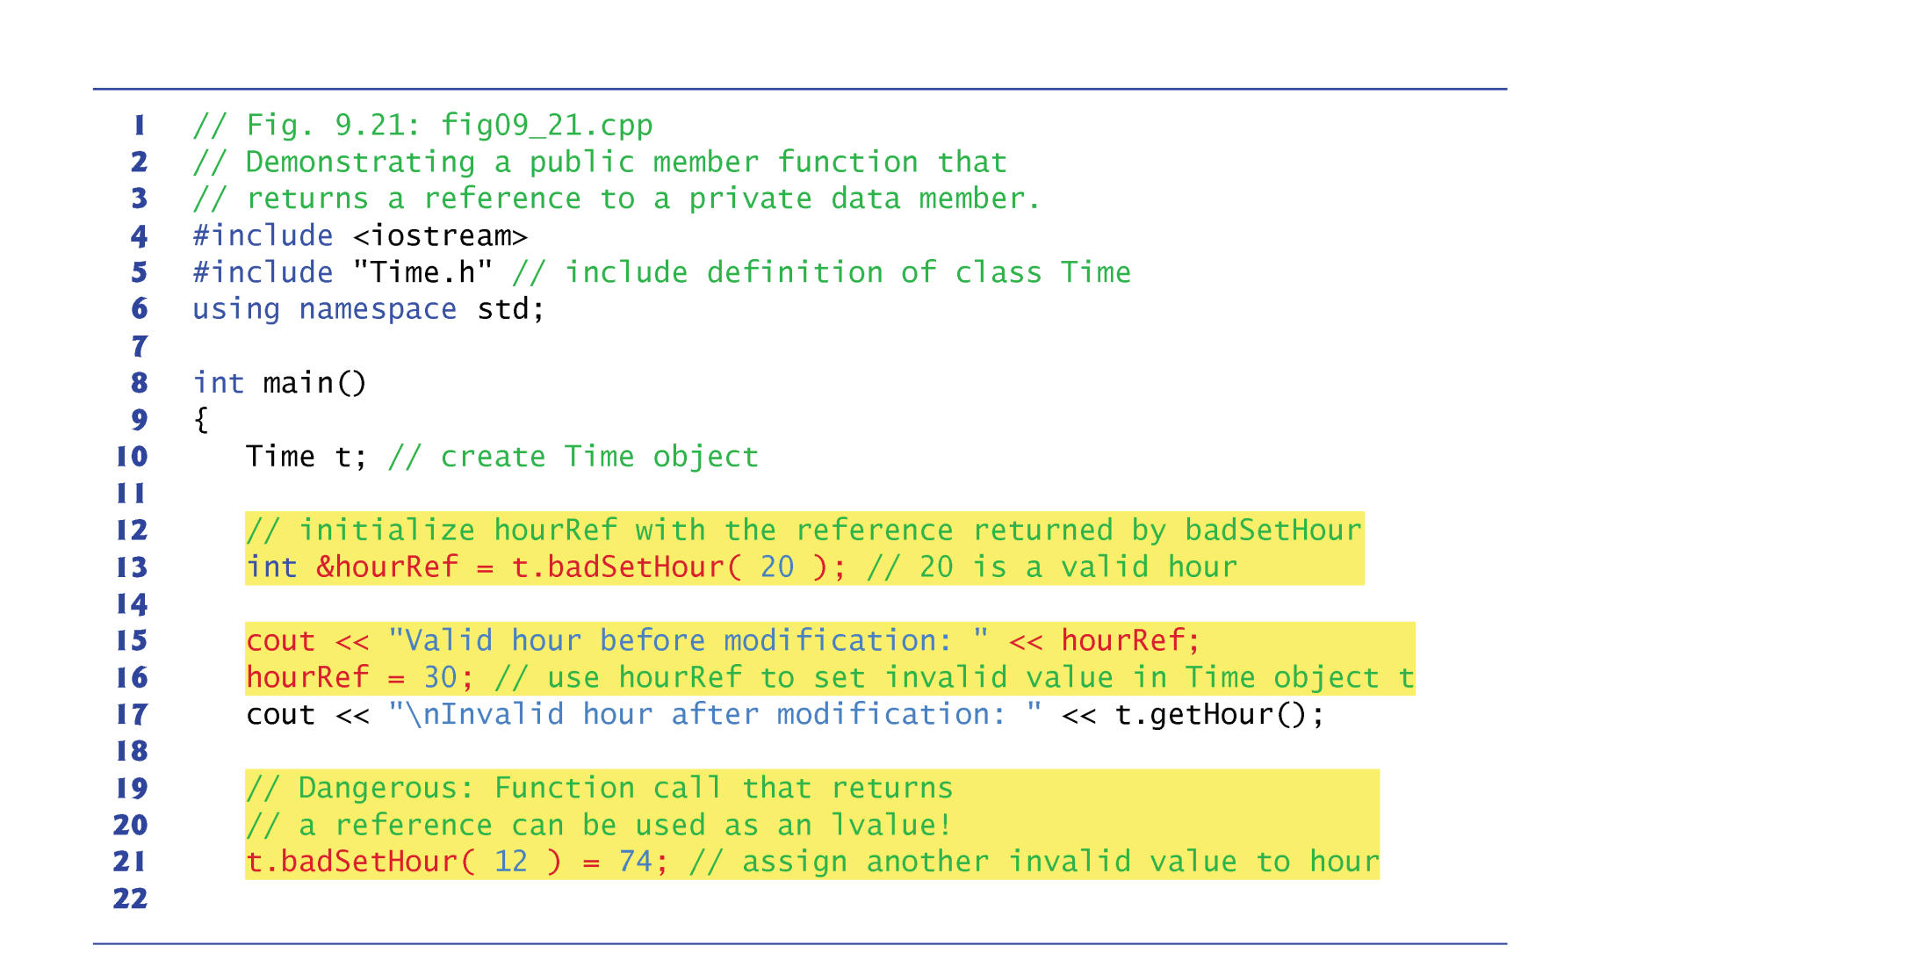
Example

Slide 35
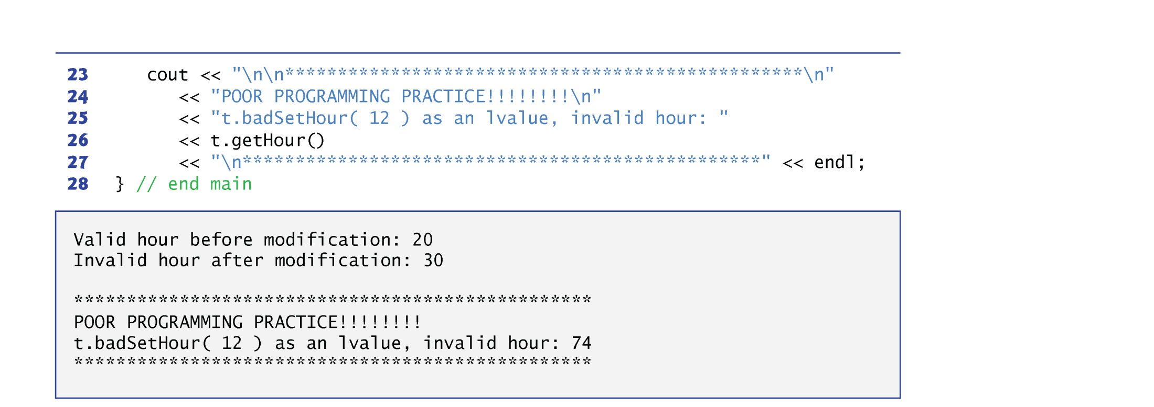
Example

Slide 36
Summary
Constructor vs Destructor
Member scope
Public
Private
Protected
Access member data

